Slide 1
BUSINESS PROCESS REENGINERING
& CONTINUOUS IMPROVEMENT
Cdr Vijay Pratap Singh
Adjunct professor

Slide 2
Learning Objectives
BUSINESS PROCESS REENGINEERING | CONTINUOUS IMPROVEMENT
Definition | Definition
Benefits
Process | Process
Example | Example
DIFFERENCES BETWEEN BUSINESS REENGINEERING AND CONTINUOUS IMPROVEMENT
DIFFERENCES BETWEEN CONTINUOUS IMPROVEMENT AND KAIZEN COSTING

Slide 3





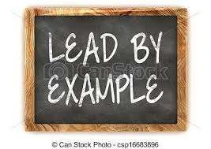
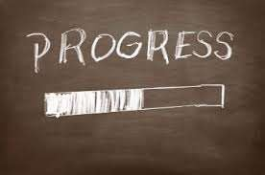

BUSINESS PROCESS REENGINEERING (BPR)

Slide 4



DEFINITION
Fundamental rethinking and RADICAL REDESIGN
of business process
COST QUALITY DELIVERY

Slide 5
BENEFITS
SYSTEMATIC
TO COMPETE
LONG TERM
SUCCESSFUL

Slide 6

5 MAJOR STEPS :
Prepare a business process map
Establish goals Reorganize work flow
Implementation
Evaluate

Slide 7
Business Process Reengineering Steps
Step 1: Set the vision and business goals.
Step 2: Establish a competent team.
Step 3: Understand the current process.
Step 4: Redesign the process.
Step 5: Implement the reengineered process.

Slide 8
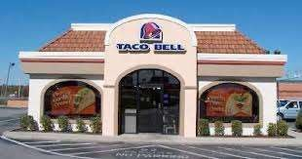
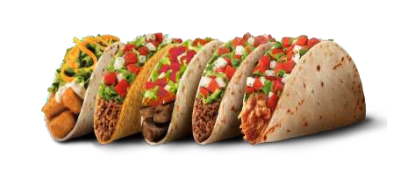
TACO BELL
MEXICAN STYLE FOOD

Slide 9
EXAMPLE –TACO BELL
PROBLEMS
1) Lack of business vision
2)Reliance on obsolete mgt and operational practices -focus more on PROCESS > customer
3)Multiple level of mgt
4)Traditional approaches -assumed customers wanted without asking them
5)Invest more in kitchen area
REENGINEERED SOLUTION
1) Complete reorganize HR
2) Dramatic redesign of operational system
3) Replace area supervisors with market managers and reduce their number
4)Changed kitchen structure Kitchen area 70% to 30% Customer area 30% to 70% Doubling the seating capacity

Slide 10
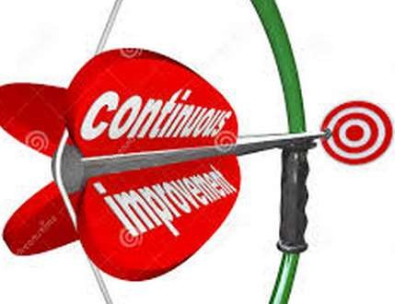
CONTINUOUS PROCESS IMPROVEMENT (CPI)

Slide 11
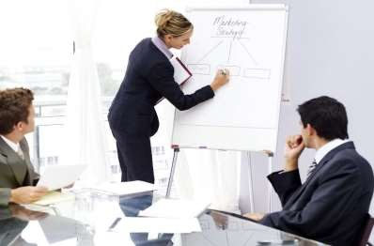
DEFINITION
incremental (minor) improvements that is NOT drastic to improve products, services or processes
e.g reduce time of production process

Slide 12




PROCESS
PLANNING
Identify current process,
procedure or workflow.
ACT
Standardize on new process
DO
Implement solution
CHECK
monitor result

Slide 13

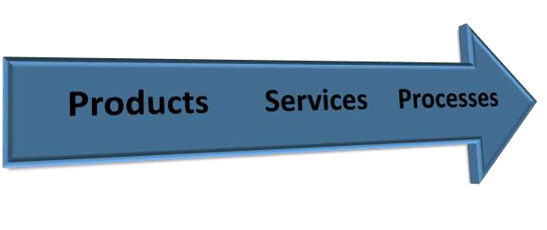
EXAMPLE

Slide 14
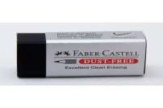
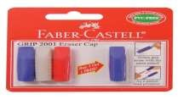
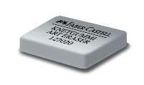
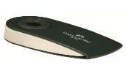
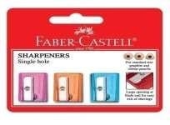
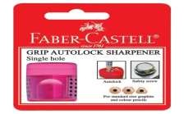
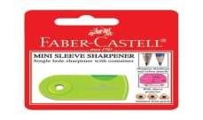
Products
Comes out with updated stylish in-trend design, based on their targeted customer

Slide 15
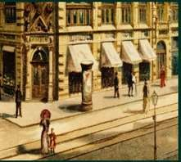
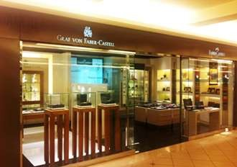
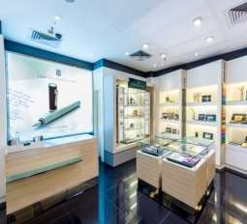
Services
Faber House in Berlin, located at centre of the city
Have branches all over the world, provide after-sale services

Slide 16
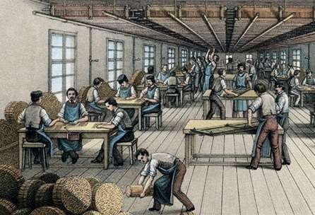
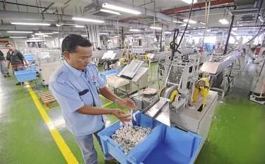
Processes
Introduced segregation of duties-based on the genders
Focus on giving motivation to workers-as they believe the workers are the heart of the company

Slide 17












DIFFERENCES BETWEEN BUSINESS REENGINEERING AND CONTINUOUS IMPROVEMENT
WHO LEADS?
BPR VS CPI
COST
TYPE OF PROCESS
SCOPE

Slide 18

DIFFERENCES OF CONTINUOUS IMPROVEMENT & KAIZEN COSTING
Continuous Improvement | Kaizen Costing
Desired consequences(result) | A tool to achieve it
System derived from targeted goals | Single activity, involve in the scope of continuous improvement
Goal is to improve better | Eliminate root of cause of problem
Perfect cake | Mixing ingredients

Slide 19


Slide 20
Q&A SESSION

